Slide 1


Crime data analytics
[STUDENT NAME]

Slide 2


Introduction
This data analytics projects is about analyzing the crime scenario of the San Francisco City.
The data is collected from the Kaggle open dataset.
https://www.kaggle.com/pateldeep7799/crime-analysis-of-sanfrancisco?
The data set includes more than, 100000 rows of data.
Notes:
This data analytics projects is about analyzing the crime scenario of the San Francisco City. The data is collected from the Kaggle open dataset. The data set includes more than, 100000 rows of data. Link of the data set is given below;
https://www.kaggle.com/pateldeep7799/crime-analysis-of-sanfrancisco?

Slide 3
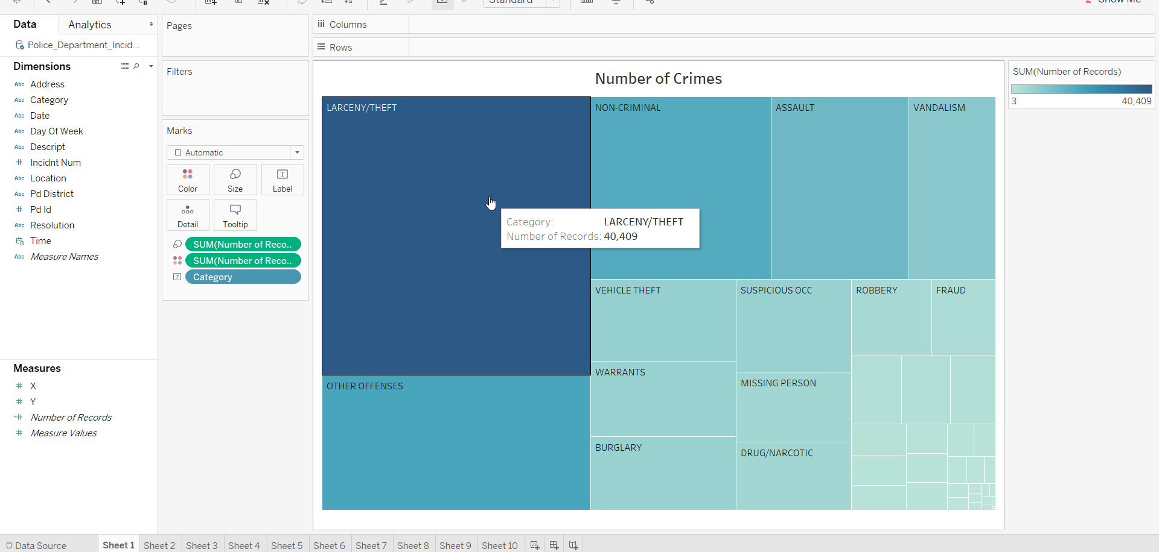
Data Insights
Initially the number of crimes recorded in the dataset is plotted using Tree-Map.
Here it can be stated that highest number of crimes are recorded under the category Larceny/theft.
Other significant crime categories are, vehicle theft, burglary, robbery, vandalism.
Notes:
In the plot, the number of crimes recorded in the dataset is plotted in Tree-Map. Maximum crimes are recorded under the category Larceny/theft.
Other significant crime categories are, vehicle theft, burglary, robbery, vandalism.

Slide 4
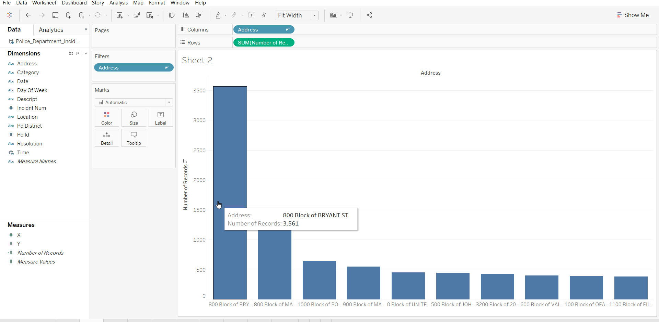
Data Insights(Contd..)
Here, in order to find out the most vulnerable areas the plot for the addresses against the number of crimes.
Top 10 addressees are depicted in the plot given at the side.
Most number of crimes are recorded in 800 Block of BRYANT ST.
The number of crimes is 3561 in that area.
Notes:
For finding out the most vulnerable areas the plot for the addresses against the number of crimes. Top 10 addressees are depicted in the plot given at the side. Most number of crimes are recorded in 800 Block of BRYANT ST. The number of crimes is 3561 in that area.

Slide 5
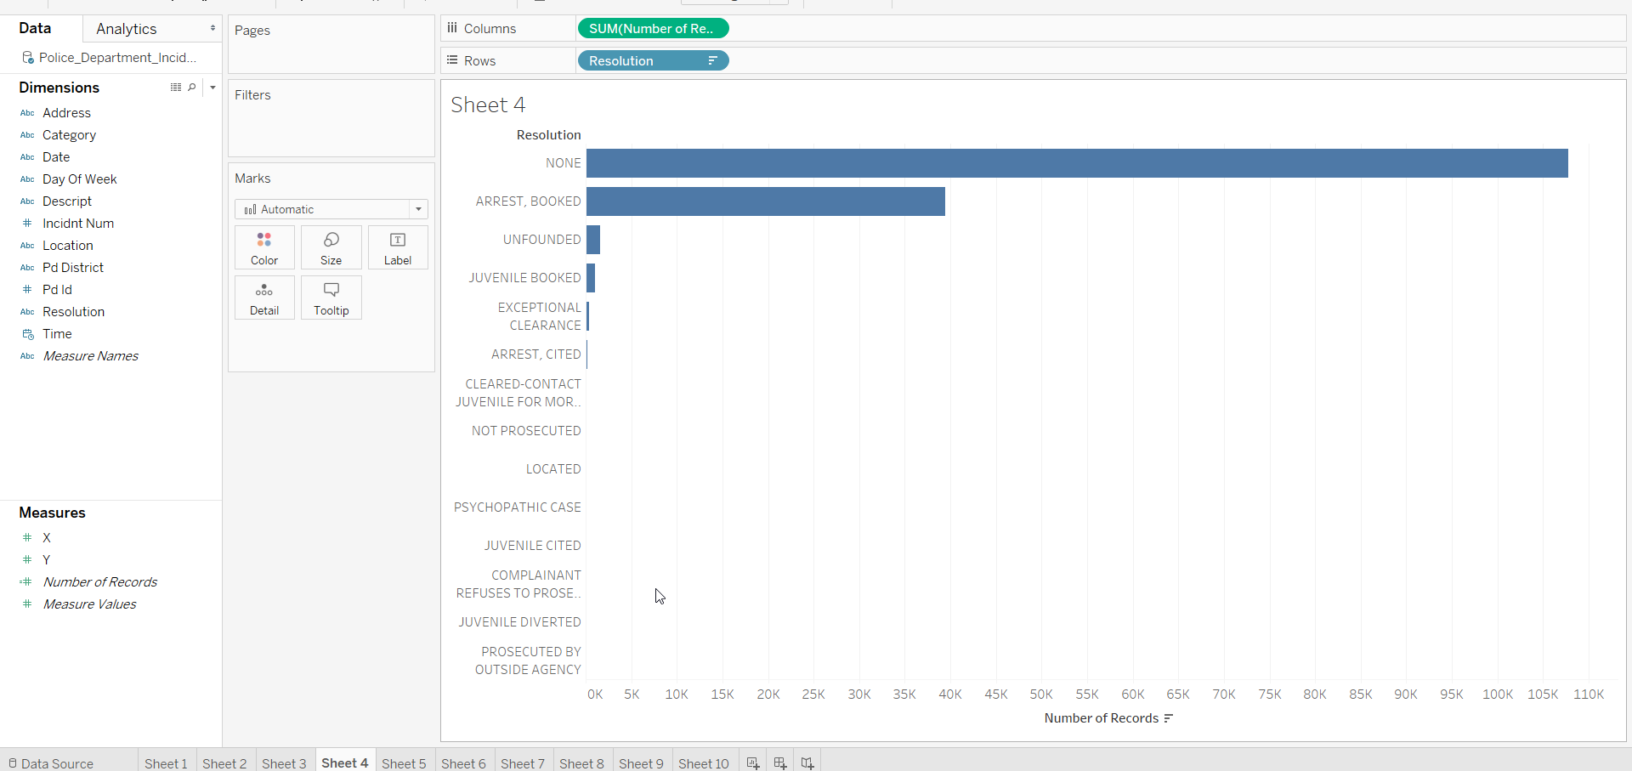
Data Insights(Contd..)
In this part the resolutions for the recorded crime is plotted in order to find out the conviction rate.
The plot depict that there are minimal convictions or arrests are done against the recorded crimes.
One of the most important point was juvenile booked for the crimes which implies that there are significant number of crimes attempted by kids.
Notes:
The above plot shows the resolutions for the recorded crime is plotted in order to find out the conviction rate. The plot depict that there are minimal convictions or arrests are done against the recorded crimes. One of the most important point was juvenile booked for the crimes which implies that there are significant number of crimes attempted by kids.

Slide 6
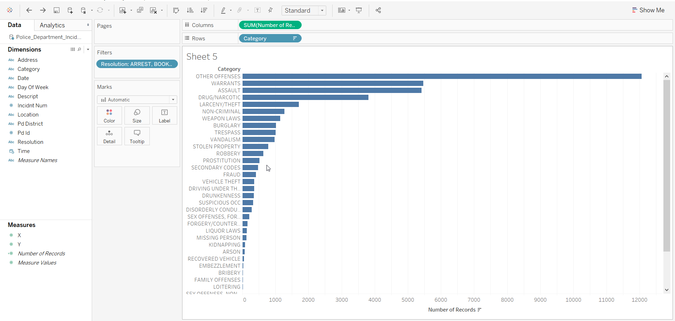
Data Insights(Contd..)
For the category of the crimes, the number of records are plotted using the horizontal bar plot.
Here, it is clearly visible that maximum number of records are categorized under Other offences, Warrant.
Other significant categories are assault, robbery, category etc.
Notes:
In the given plot, the category of the crimes and their number of records are plotted using the horizontal bar plot. Here, it is clearly visible that maximum number of records are categorized under Other offences, Warrant. Other significant categories are assault, robbery, category etc.

Slide 7
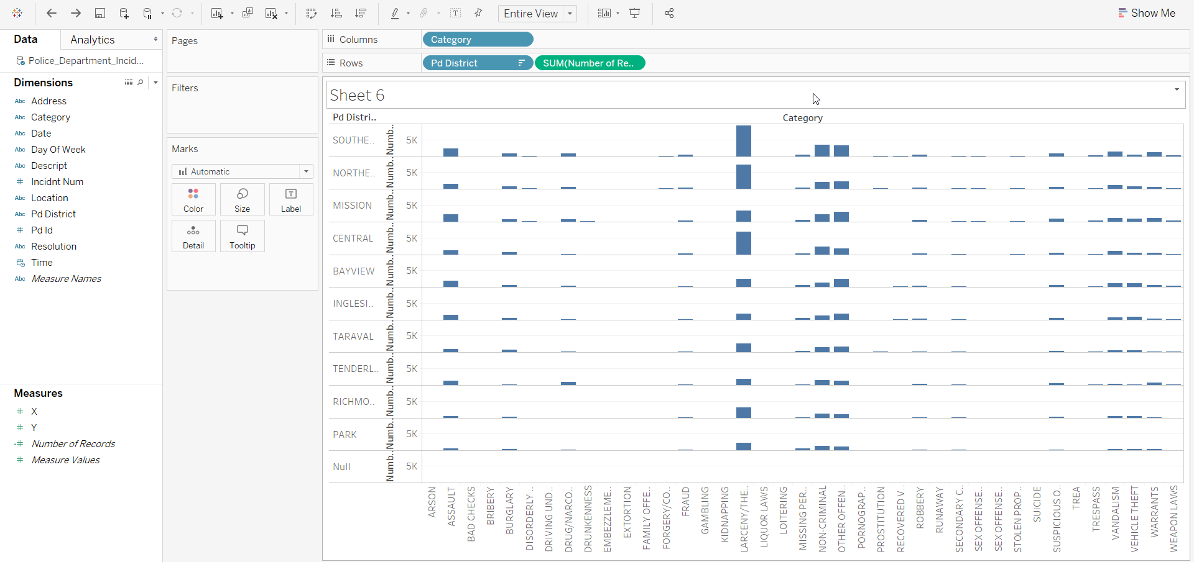
Data Insights(Contd..)
In this section the crimes in the different districts are depicted.
The plot at the side shows that for the Mission Pd district had highest records for the drug crime cases.
In case of other crime categories the southern PD district had the highest crime records.
Notes:
In this section the crimes in the different districts are depicted. The plot at the side shows that for the Mission Pd district had highest records for the drug crime cases. In case of other crime categories the southern PD district had the highest crime records.

Slide 8
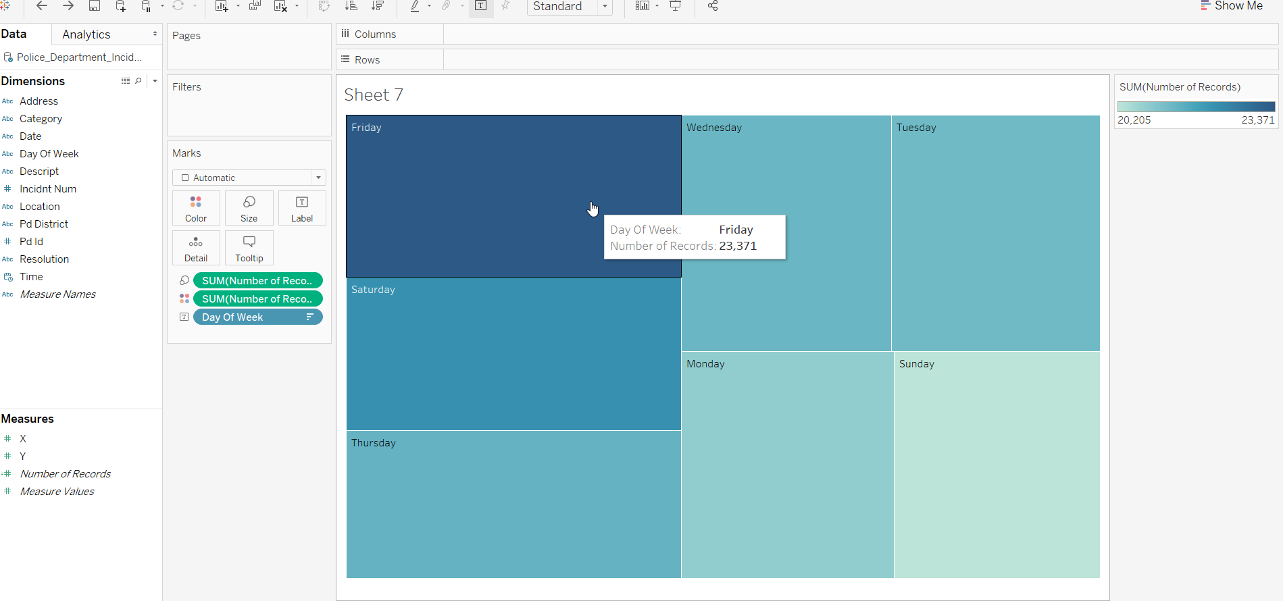
Data Insights(Contd..)
In this plot the day with most crime recorded is investigated.
From the graph at the side, it can be stated that maximum number crimes are recorded on Fridays.
Least number of crime is recorded on Sundays.
Notes:
In this plot the day with most crime recorded is investigated. From the graph at the side, it can be stated that maximum number crimes are recorded on Fridays. Least number of crime is recorded on Sundays. Thus the Fridays are most busy days.

Slide 9
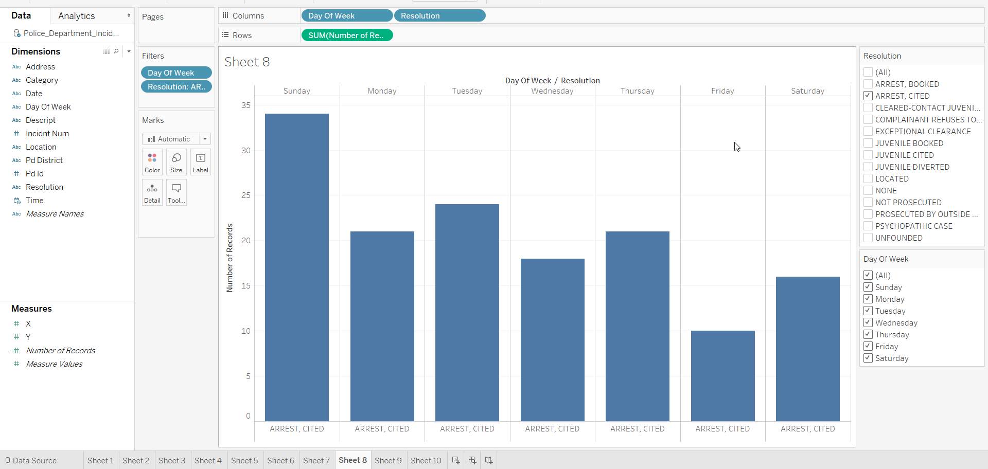
Data Insights(Contd..)
For this plot, the count of resolutions for different days are plotted.
For the arrests/cited the count is highest for the Sundays.
The count is minimum for the Fridays.
Notes:
For this plot, the count of resolutions for different days are plotted. For the arrests/cited the count is highest for the Sundays. The count is minimum for the Fridays.

Slide 10
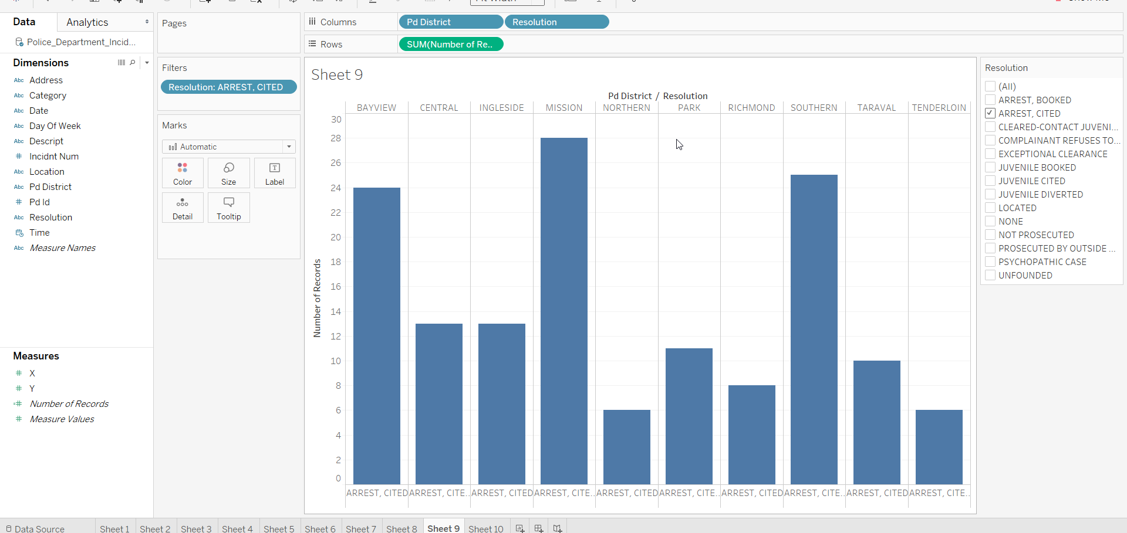
Data Insights(Contd..)
In this section the counts of Arrest/Cited resolution are compared against the Pd districts.
Here highest number of convictions are in Mission district.
Lowest number of convictions are in Tenderloin.
Notes:
In this section the counts of Arrest/Cited resolution are compared against the Pd districts. Here highest number of convictions are in Mission district. Lowest number of convictions are in Tenderloin.

Slide 11
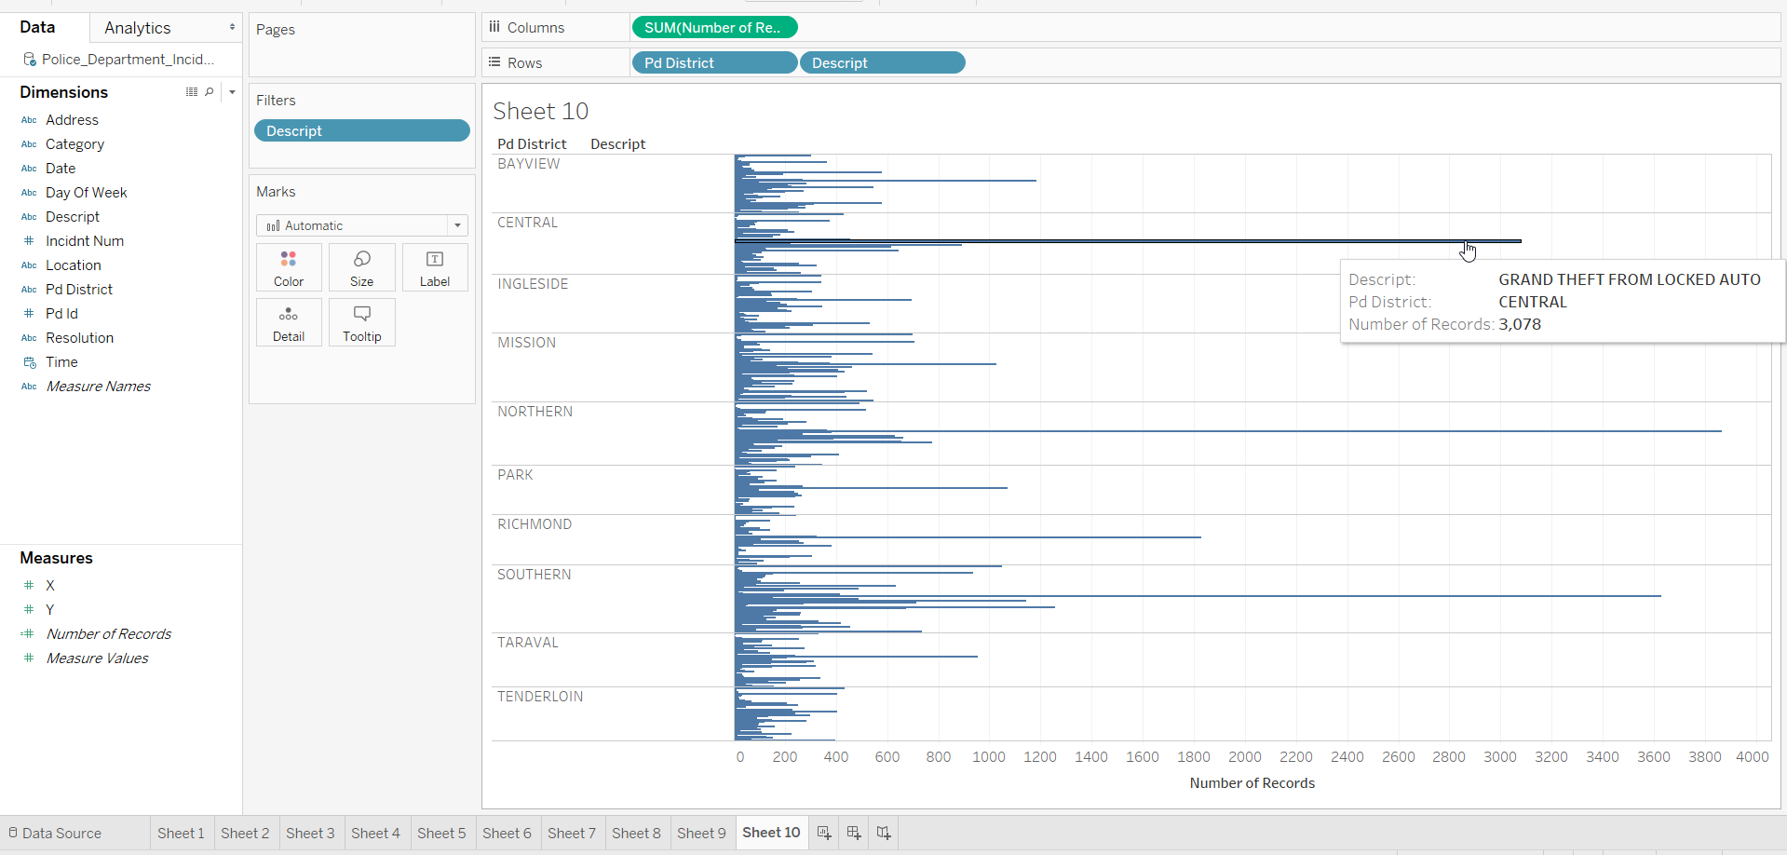
Data Insights(Contd..)
In this plot the count of crimes are plotted in the different Pd districts.
From the plot, it is clear that highest number of descriptions are available for Auto theft.
The highest count is also recorded in the northern Pd district.
Notes:
In this plot the count of crimes are plotted in the different Pd districts. From the plot, it is clear that highest number of descriptions are available for Auto theft. The highest count is also recorded in the northern Pd district.

